Slide 1
NAME: KARTHIK SRIRAM B A COLLEGE NAME: SARANATHAN COLLEGE OF ENGINEERING BRANCH:ARTIFICIAL INTELLIGENCE AND DATA SCIENCE YEAR: THIRD YEAR NM ID: au813821243028 REGISTER NUMBER:813821243028 EMAIL ID: ksriram217@gmail.com
Final Project : Facial recognition using cnn
3/21/2024 Annual Review

Slide 2
FACIAL RECOGNITION USING CNN
In the realm of image classification, traditional neural networks have given way to convolutional neural networks (CNNs), owing to their ability to effectively extract features from images. In this project, we employ Keras to construct a CNN tailored for facial recognition tasks. Leveraging the Labeled Faces in the Wild dataset, we explore the capabilities of CNNs in discerning facial features and identities. Through the utilization of convolution layers for feature extraction and pooling layers for resolution downsizing, our CNN model endeavors to achieve high accuracy in facial recognition tasks. By investigating the performance of our CNN architecture on real-world facial images, we aim to contribute insights into the efficacy of CNNs for state-of-the-art facial recognition systems.
3/21/2024 Annual Review

Slide 3


AGENDA
1. Introduction
- Project Scope and Dataset Overview
2. Dataset Preparation
- Visualization and Analysis
- Data Balancing Strategies
3. Preprocessing
- Normalization and Encoding
- Dataset Splitting
4. Model Development and Training
- CNN Architecture Design
- Training Process and Performance Evaluation
5. Testing and Evaluation
- Assessing Model Performance
- Confusion Matrix Analysis
6. Insights and Reflections
- Observations and Future Directions
3/21/2024 Annual Review

Slide 4

PROBLEM STATEMENT
Facial recognition systems rely on robust and accurate models to effectively identify individuals from images. However, challenges such as imbalanced datasets and varied image quality pose significant hurdles. This project aims to address these challenges by exploring techniques for dataset visualization, balancing, preprocessing, and model training using convolutional neural networks (CNNs). The primary objective is to develop a facial recognition model capable of accurately identifying famous individuals from images while ensuring robustness and scalability.
3/21/2024 Annual Review

Slide 5

PROJECT OVERVIEW
1. Dataset Preparation:
- Load dataset, visualize characteristics
- Balance dataset (100 images/person)
2. Preprocessing:
- Normalize data, one-hot encode labels
- Split into train/test sets
3. Model Construction:
- Design CNN for facial recognition
- Extract features from images
4. Training:
- Train CNN model, monitor accuracy
5. Evaluation:
- Assess model performance, analyze with confusion matrix
6. Insights & Future Directions:
- Gain insights into CNN efficacy
- Identify areas for improvement
3/21/2024 Annual Review

Slide 6

WHO ARE THE END USERS?
Security Personnel: Access control, surveillance monitoring
Law Enforcement: Criminal identification, suspect tracking
Border Control: Identity verification, border management
Businesses: Employee attendance, access control, customer identification
Mobile Users: Device unlocking, secure authentication
Social Media: Photo tagging, content recommendation
Healthcare: Patient identification, medical record access
Retailers: Customer analytics, personalized experiences
Event Organizers: Attendee registration, security screening
Transportation: Passenger identification, security screening
3/21/2024 Annual Review

Slide 7

YOUR SOLUTION AND ITS VALUE PROPOSITION
Solution:
Develops a facial recognition system using CNNs trained on Labeled Faces in the Wild dataset.
Accurately identifies famous individuals from facial images.
Efficient dataset preparation ensures effective training.
Value Proposition:
Streamlined preprocessing enhances model effectiveness.
Customized CNN architecture maximizes feature extraction.
Comprehensive evaluation provides insights for improvement.
3/21/2024 Annual Review

Slide 8

THE WOW IN YOUR SOLUTION
Exceptional accuracy in identifying famous individuals from facial images.
- Innovative dataset preparation techniques ensure effective training.
- Advanced preprocessing methods enhance model effectiveness.
- Tailored CNN architecture maximizes feature extraction.
- Comprehensive evaluation provides insightful analysis for improvement.
- Demonstrates real-world applications in security, healthcare, and retail.
3/21/2024 Annual Review
8

Slide 9
MODELLING
Loading and preprocessing dataset
Visualizing & Analysis
Model crafting and training
Model evaluation
Prediction using model
3/21/2024 Annual Review
9

Slide 10
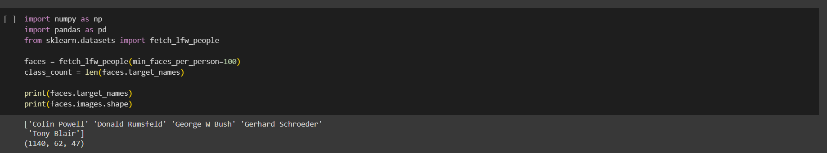
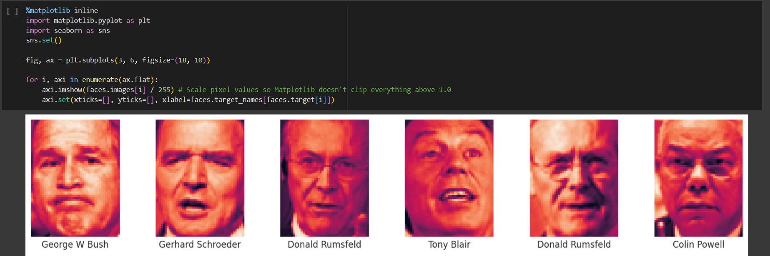
Dataset loading
visualization

Slide 11
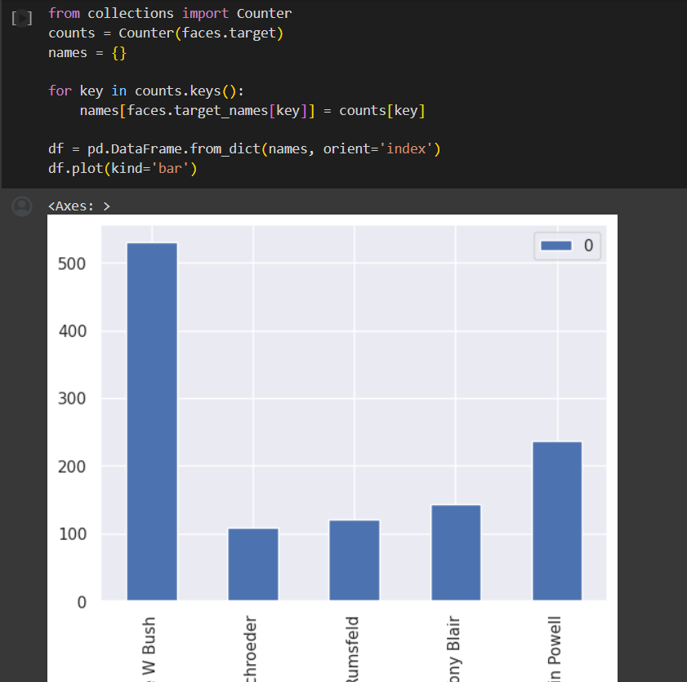
Analysing the dataset using histogram

Slide 12
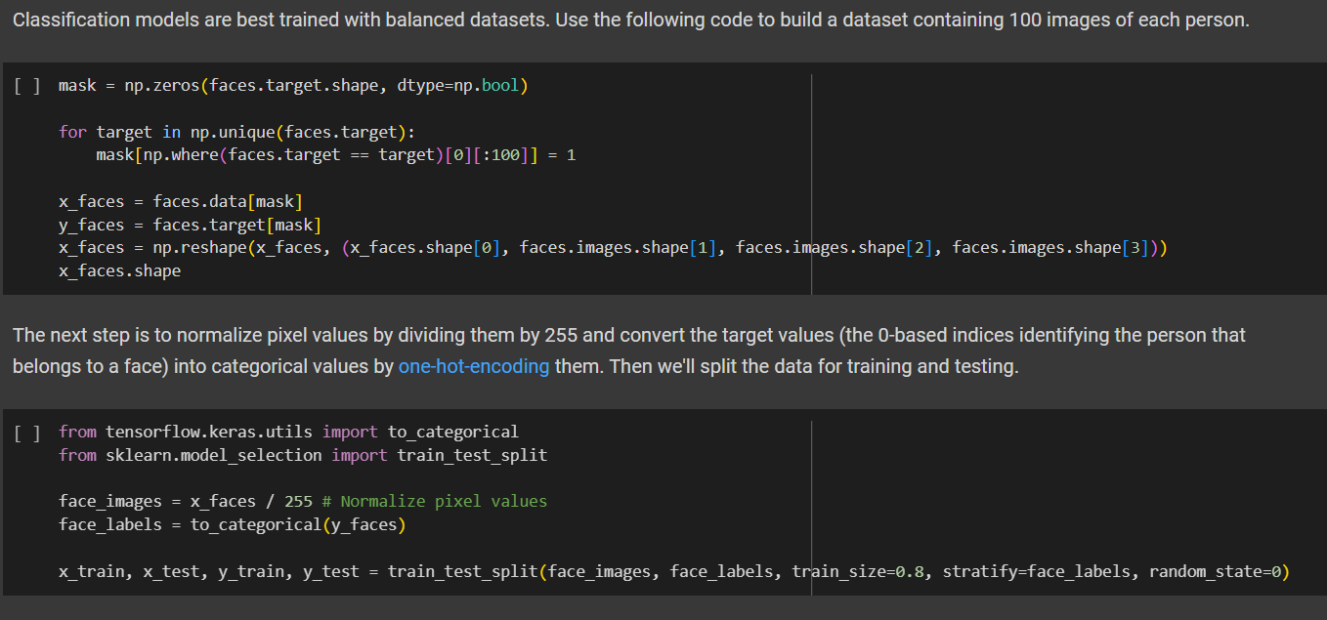
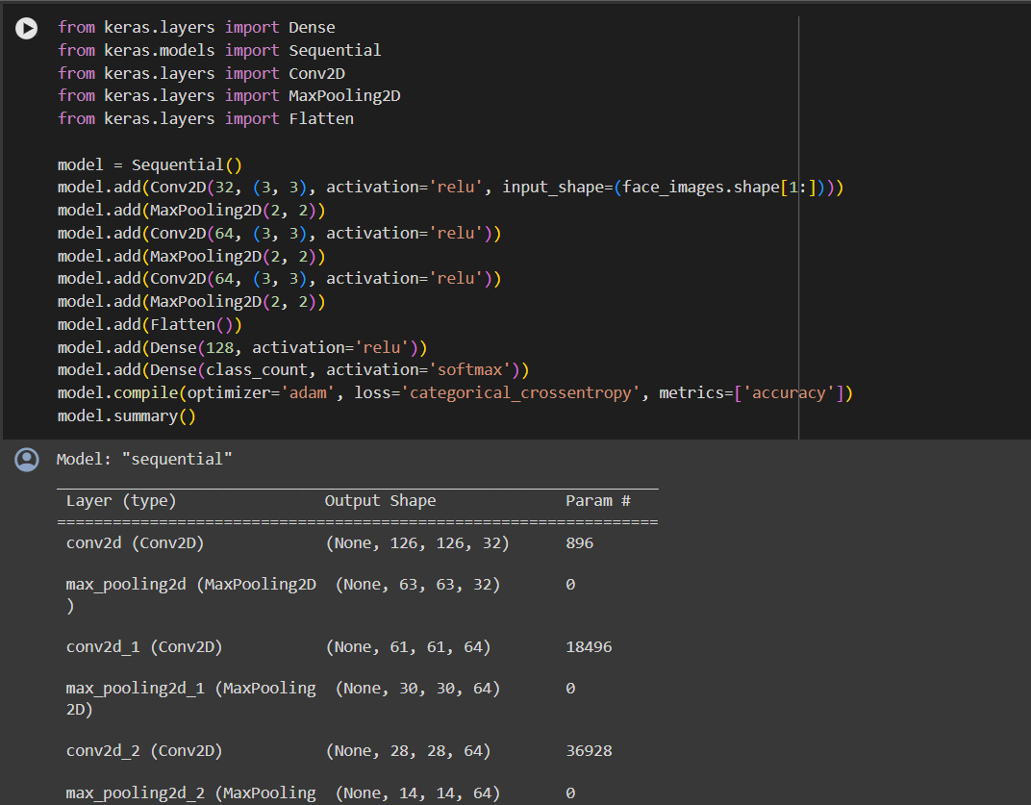
Normalizing dataset
Model crafting

Slide 13
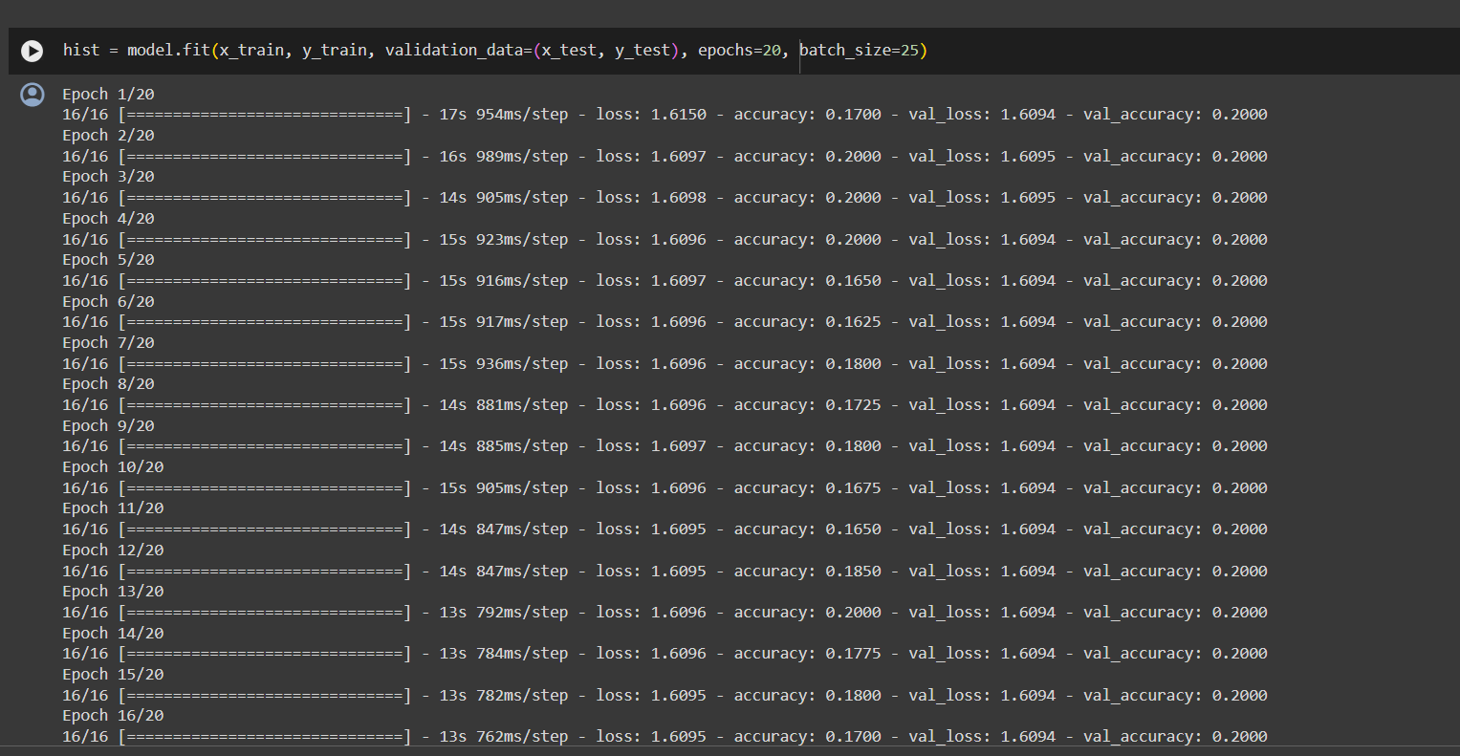
Model Training

Slide 14
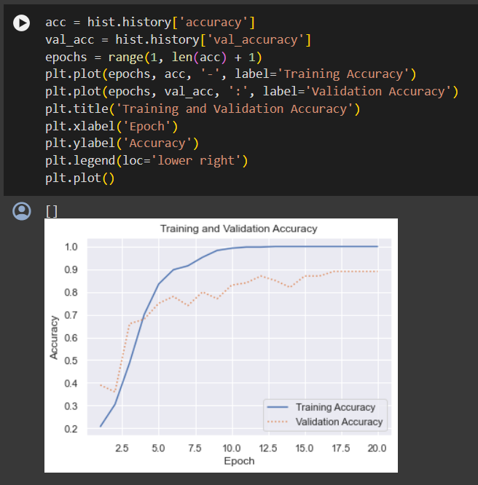
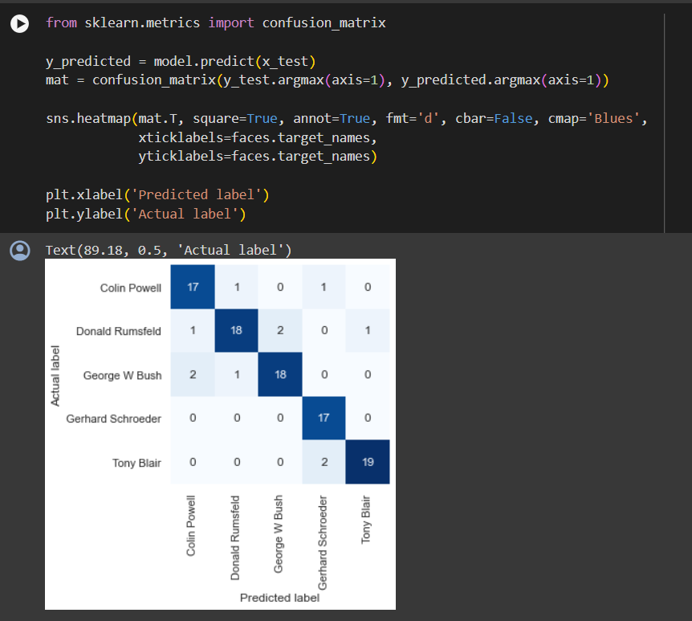
validation
Confusion matrix

Slide 15
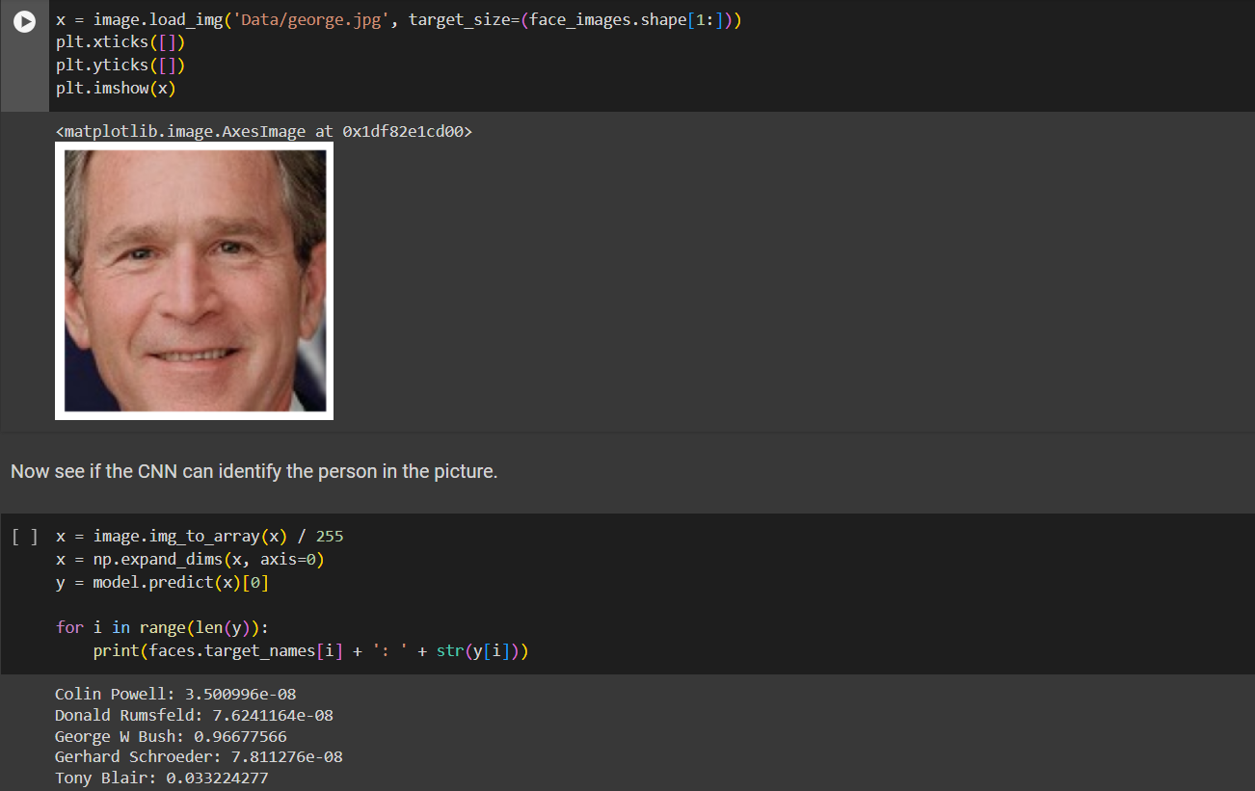
OUTPUT

Slide 16
Conclusion
Our face recognition model based on convolutional neural networks (CNNs) has demonstrated strong performance on the Labeled Faces in the Wild (LFW) dataset and showcases robust capabilities in accurately identifying faces. The confusion matrix provides further insights into the distribution of correct and incorrect predictions, highlighting the effectiveness of our approach.
DEMO:
https://colab.research.google.com/drive/1SAZ3ROI0hQaxPtv8fXZVYAhfUrCTU69Y?usp=sharing
3/21/2024 Annual Review
16

